Slide 1
SMART DISEASE DETECTION SYSTEM IN PLANTS
BY: Guide By:-
Rohan O Chikorde Prof. Prasad Pujar
Shubhma Godse Dept CSE
Abhishek Shelke
Ifran Hussian

Slide 2

Contents:
Introduction
Literature review
Objectives
Existing Methodology
Proposed Methodology
System Design
Road Map
References

Slide 3
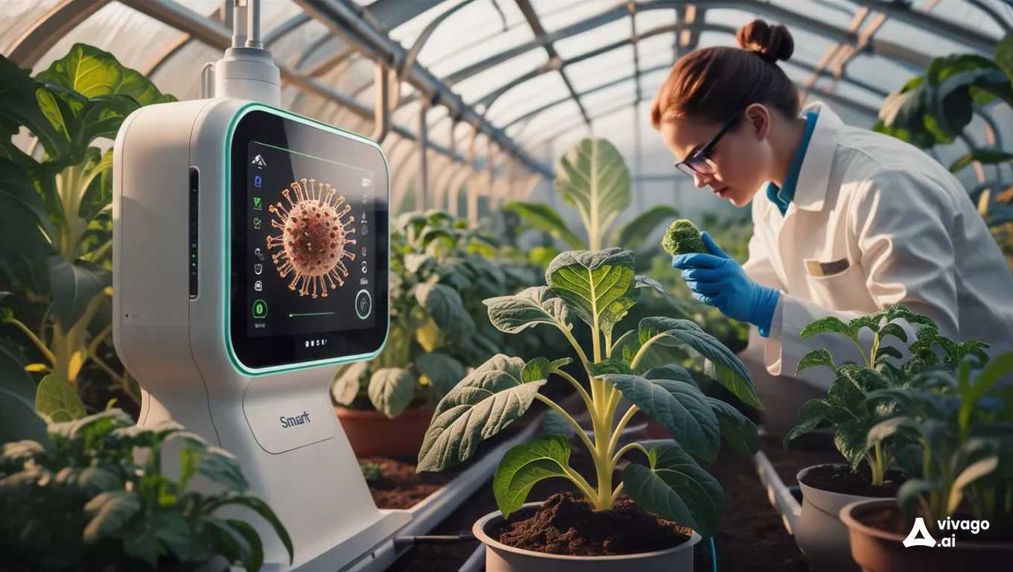
INTRODUCTION
A Smart Disease Detection System in plants and crops refers to the utilization of advanced technologies such as machine learning to accurately identify, diagnose, and monitor diseases affecting agricultural plants and crops.
The goal of these systems is to improve the efficiency and precision of disease detection, enabling farmers to implement timely and effective management strategies to protect crop health and enhance agricultural productivity..

Slide 4

LITERATURE REVIEW
Diagnosing plant diseases is a crucial part of contemporary agriculture, as it significantly affects crop output and food security. [1]
Conventional diagnostic techniques frequently require a lot of work and time, and they mostly rely on laboratory analysis and professional expertise. [2]
Plant illnesses are typically primarily identified by looking at the leaves of the plants, as most disease signs can first be seen on the leaves. [3]
The incorporation of convolutional neural networks (CNNs) has greatly increased the accuracy of disease detection, allowing the system to identify a variety of diseases in different plant species.[4]
Several advantages might arise from automating the plant disease detection process, such as enhanced precision, rapid diagnosis, and the capacity to oversee extensive fields with no human involvement. Plant disease classification and identification systems can be developed from leaf photos by utilizing advances in visual analysis and machine learning.[5]
Notes:
‘Automatic plant pest detection and recognition using k-means clustering algorithm and correspondence filters

Slide 5

OBJECTIVES
Enhance Early Disease Detection: Develop an automated system capable of identifying diseases at the earliest stage to prevent their spread and reduce crop losses.
Increase Detection Accuracy: Utilize advanced machine learning and computer vision techniques to accurately detect and classify various crop diseases across different plant types.
Promote Cost-Effectiveness: Ensure the system is cost-effective for small-scale farmers, making advanced disease detection technology accessible to a broader agricultural community.
Facilitate User-Friendly Access: Develop a user-friendly interface for farmers, allowing easy access to disease detection reports, monitoring data, and alerts via mobile devices or web platforms.

Slide 6

EXISTING METHODOLOGY
Traditional Visual Inspection Description: Farmers or agricultural experts manually inspect crops for signs of disease, often identifying issues based on color changes, spots, or deformities in leaves and stems.
Like (Powdery Mildew, leaf spot…..)
Limitations:
This method is time-consuming, requires expertise, and is prone to human error. Like
Early disease symptoms may be difficult to detect visually, leading to delays in intervention.

Slide 7

PROPOSED METHODOLOGY
Data Collection: Capture plant images, deploy IoT sensors (temperature, humidity, soil moisture) for real-time monitoring, and use historical disease data.
Data Preprocessing: Enhance image and sensor data quality; label images with disease types for accurate model training.
Model Training: Train a CNN for image-based disease detection, apply transfer learning for adaptability, and develop models to analyze environmental data from IoT sensors.
Interface: Provide a mobile app and dashboard for easy access to disease diagnostics, sensor data, and alerts.
Field Testing & Deployment: Validate in-field, deploy on cloud platforms, and maintain cost-effective, sustainable IoT solutions for continuous crop health monitoring.

Slide 8
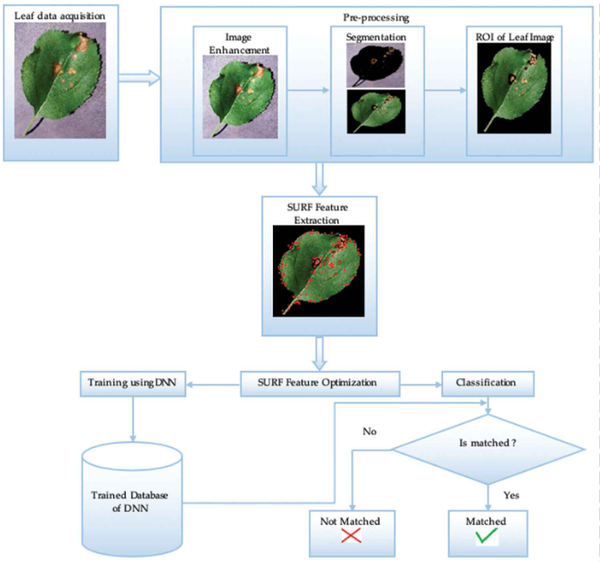
SYSTEM DESIGN
Segmentation: This sub-step involves separating the leaf from the background.
ROI (Region on Interest) of Leaf Image: The segmented leaf image is obtained, highlighting the specific areas of the leaf that need to be analyzed for disease symptoms.
Speeded-Up Robust Features (SURF) is an algorithm used for feature detection. In this step, SURF is applied to extract key features from the leaf image.

Slide 9
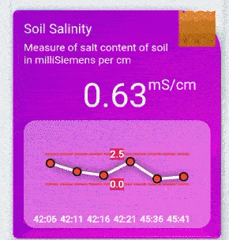
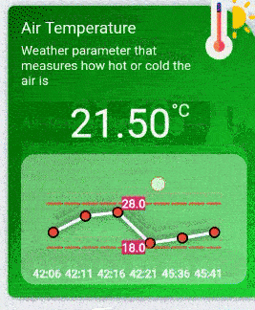
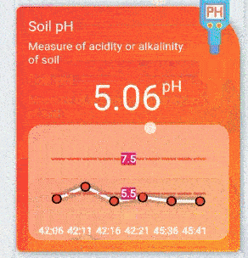

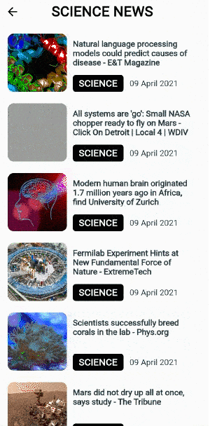
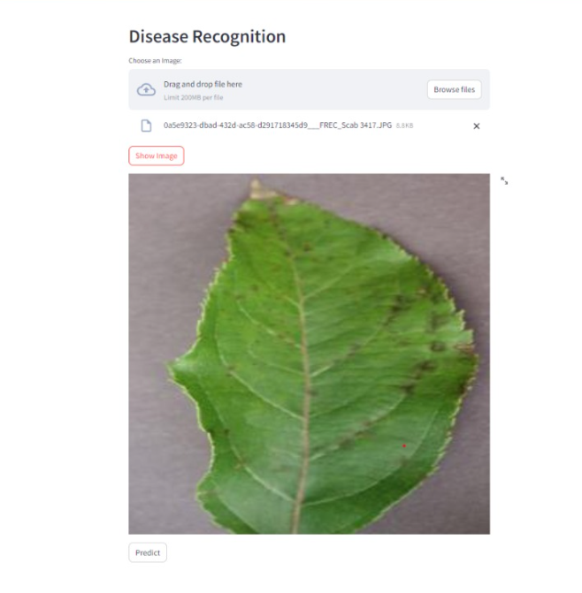
SYSTEM DESIGN

Slide 10


ROAD MAP
Research & Planning
Technology Selection
System Design
Data Collection
Model Development
Deployment
Monitoring & Maintenance
Testing & Validation
Integration

Slide 11
REFERENCES
[1] Fina, P. Birch, R. Young, J. Obu, B. Faithpraise, and C. Chatwin, ‘‘Automatic plant pest detection and recognition using k-means clustering algorithm and correspondence filters,’’ Int. J. Adv. Biotechnol. Res., vol. 4, no. 2, pp. 189–199, Jul. 2013. The Robotic Process Automation Handbook by Tom Taulli.
[2] Journal contribution posted on 2023-06-08, 23:08 authored by Fina Faithpraise, Phil BirchPhil Birch, Rupert YoungRupert Young, “J Obu Bassey” Faith praise, Chris Chatwin.
[3] https://ijarsct.co.in/Paper2987.pdf’
[4] M. A. Ebrahimi, M. H. Khoshtaghaza, S. Minaei and B. Jamshidi, "Vision-based pest detection based on SVM classification method", Comput. Electron. Agricult., vol. 137, pp. 52-58, May 2017
[5] “An Overview of the Research on Plant Leaves Disease detection using Image Processing Techniques”, January 2014, Ms. Kiran R. Gavhale.

Slide 12
Thanks You !

